Slide 1
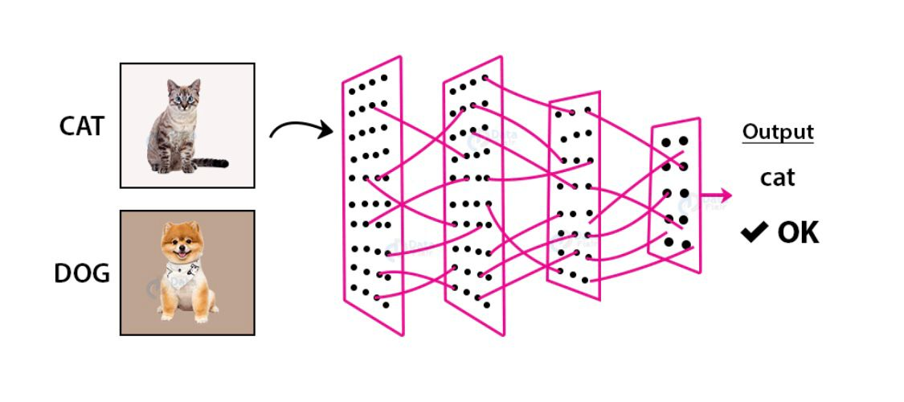
Image Recognition
Course Name:
Machine learning 1(Spring 2022)
Group Name:
Group2
Group members:
Mahtab Barkhordarian
Nusrat Nawshin

Slide 2
Introduction
Dataset
Convolutional Neural Network
Models
Results

Slide 3
Dataset
This is the built in dataset=’https://www.tensorflow.org/datasets/catalog/stl10’ which is an image recognition dataset for developing algorithms. Each class has some labeled training and test examples and unlabelled examples as well, but we are not using the unlabeled ones as we are focusing on the supervised learning.
The Dataset is separated into the train, validation and test.
Total Number of Samples | 13000
Train | 3500
Validation | 1500
Test | 8000
Target Labels: 'airplane', 'bird', 'car', 'cat', 'deer', 'dog', 'horse', 'monkey', 'ship', 'truck'

Slide 4
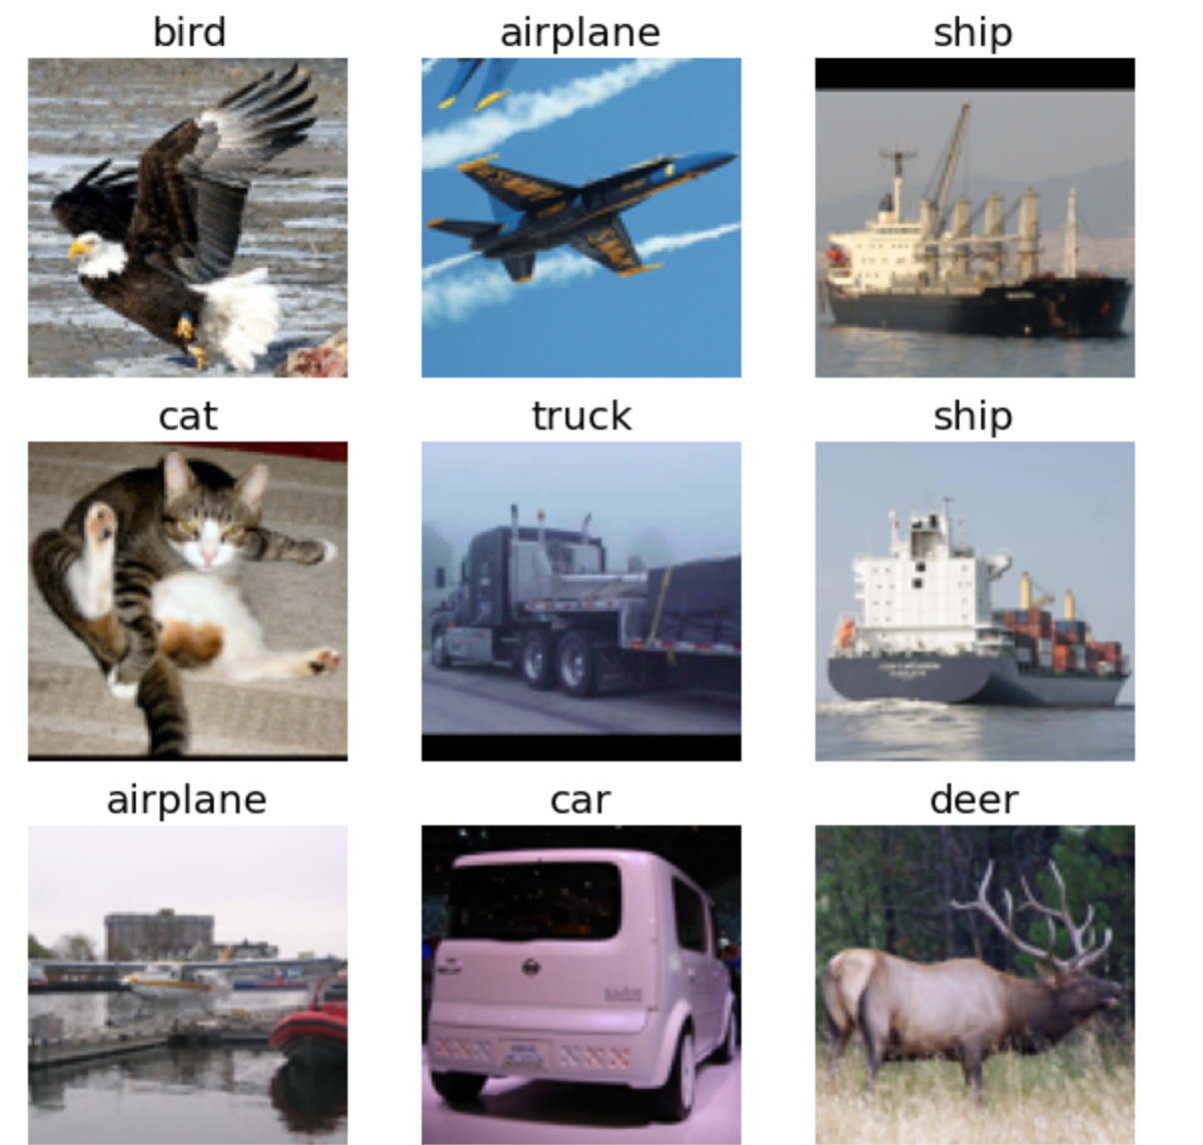
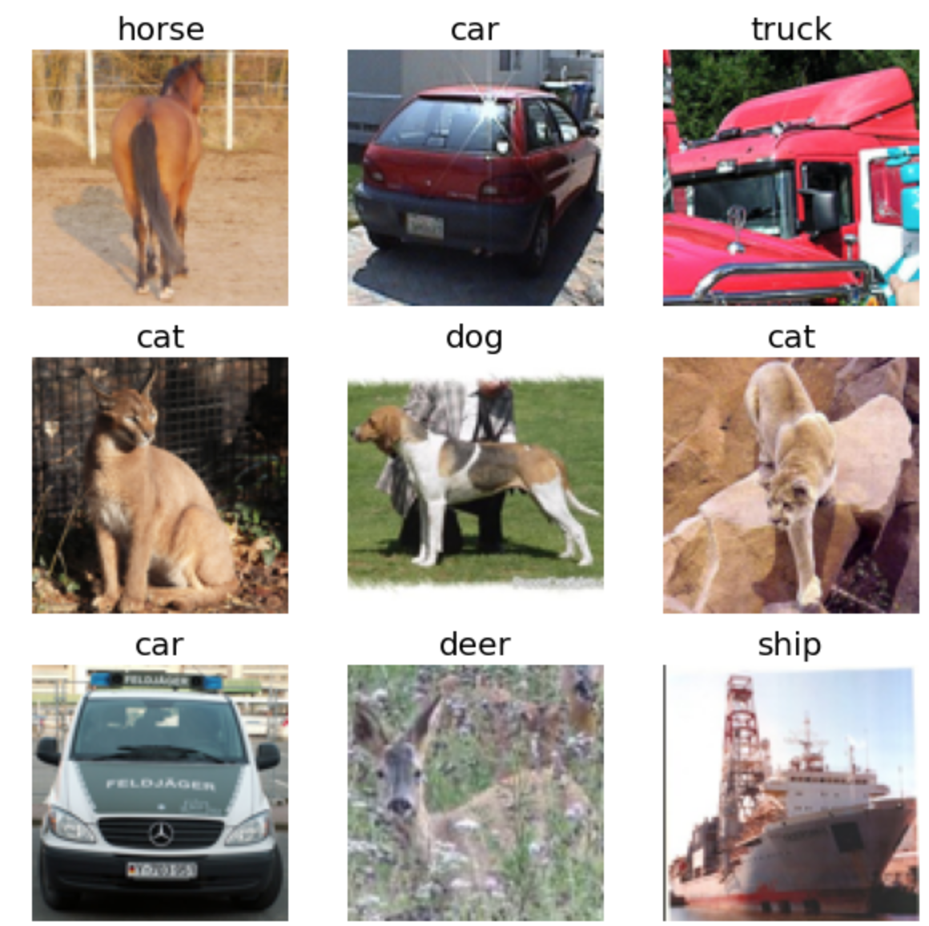
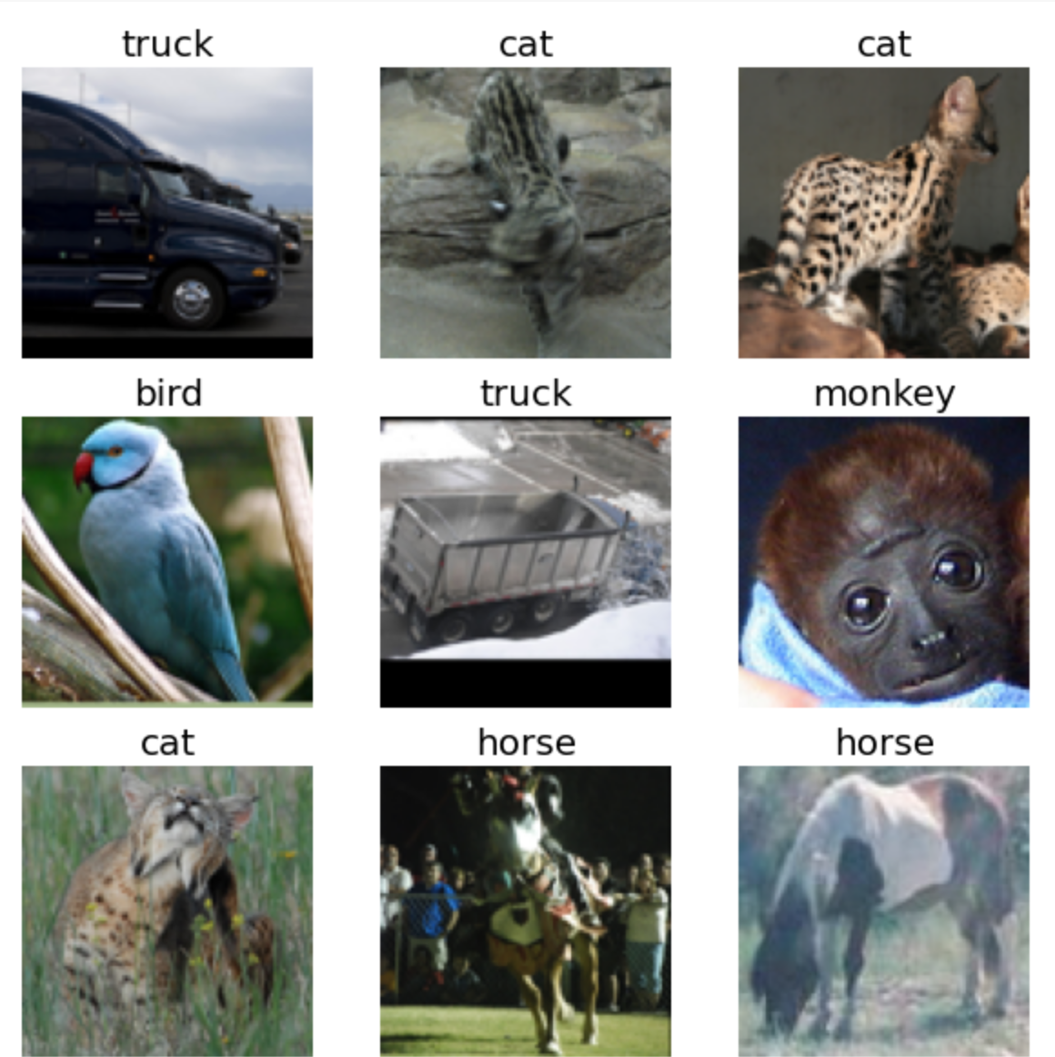
Image Samples
Train
Validation
Test

Slide 5
CNN Basic Architecture
Convolutional neural networks (CNNs) are deep neural network that have the capability to classify and segment images.
CNNs can be trained using supervised or unsupervised machine learning methods, depending on what you want them to do.
CNN architectures for classification and segmentation include a variety of different layers with specific purposes, such as a convolutional layer, pooling layer, fully connected layers, dropout layers, etc.

Slide 6
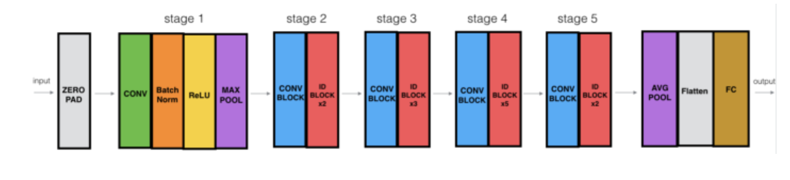
ResNet-50

Slide 7
Models and Results
Model | Network | Optimizer | Accuracy | Loss
Model 1: | ResNet50 | Adam optimizer (learning rate=1e-4) | 88.20% | 0.277
Model 2: | ResNet50 | SGD optimizer (decay=1e-4) | 96.03% | 0.1234
Model 3: | ResNet50 | SGD optimizer (decay=3e-4) | 96.71% | 0.1035
Model 4: | ResNet50 | Adam optimizer(learning rate= 1e-3) | 96.4% | 0.1117
Model 3 has the highest accuracy score

Slide 8
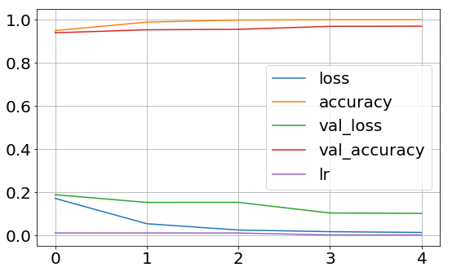
Models & Results
Final model learning curve:

Slide 9
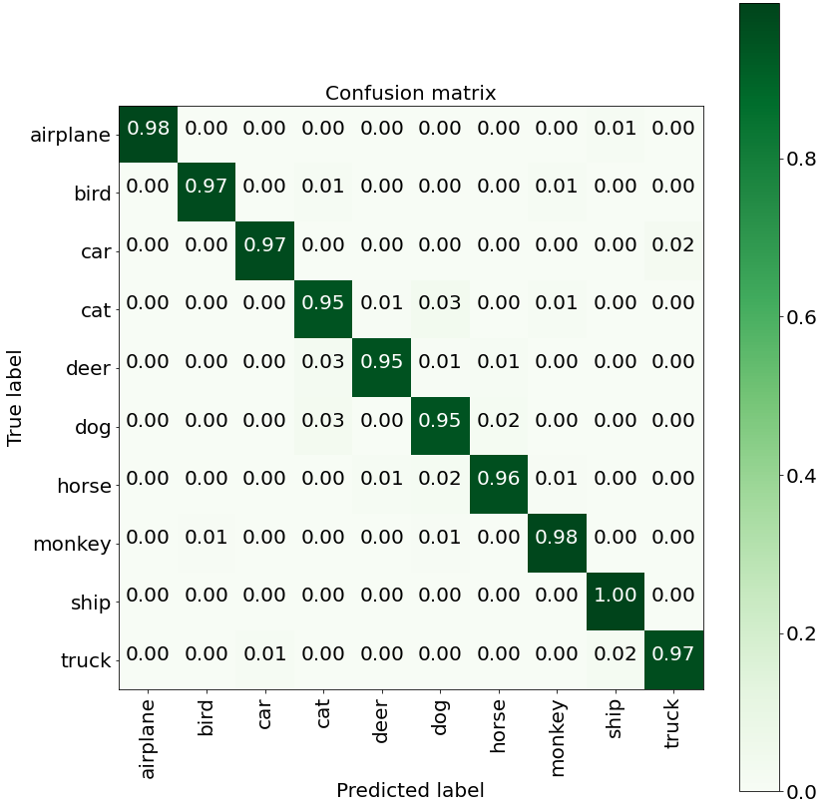
Confusion Matrix
Overall the model can detect objects very accurately
Model is best at detecting ship
Cat, deer and dog has the lowest accuracy

Slide 10
Conclusion
Final Model:
96.7% accuracy on CNN-ResNet50 with Stochastic Gradient Descent Optimizer and learning rate 3e-4
Use of our model:
Detect animals and reduce self driving car accidents on suburban highways
Create drone to identify animals in nature/forests
Detect ships in marine transportation system
Future Work:
Perform unsupervised learning with the unlabelled data

Slide 11
References
Pictures https://becominghuman.ai/building-an-image-classifier-using-deep-learning-in-python-totally-from-a-beginners-perspective-be8dbaf22dd8?gi=f6870d48e6b6
CNN Architecture https://vitalflux.com/cnn-basic-architecture-for-classification-segmentation/#:~:text=The%20CNN%20architecture%20for%20classification%20includes%20convolutional%20layers%2C,detection%2C%20max-pooling%20layers%20are%20meant%20for%20feature%20selection
Resnet-50 https://machinelearningknowledge.ai/keras-implementation-of-resnet-50-architecture-from-scratch/#:~:text=The%20ResNet-50%20model%20consists%20of%205%20stages%20each,The%20ResNet-50%20has%20over%2023%20million%20trainable%20parameters.

